Slide 1
Special Award Judging
Date: Saturday 2017
Time: 8:45 am
Place: Room 2025

Slide 2
Judging Committee
Delfina Mazzuca-Siroen Junior Life Science | Phil Dean Junior Physical Science | Jeff Regan Junior Technology | Lynn Watson-Lee Judge at Large | Susan Koval Intermediate & Senior Life Science | Jessie MacAlpine Judge at Large
John Dickinson Intermediate & Senior – Physical Science & Technology | Spencer Seiler Special Awards | Susan Lindsay Exhibition | Caroline Whippey Deputy Chief judge | Patrick Whippey Chief Judge

Slide 3
Projects 2017
Division | Life | Physical | Engineering | Elementary Exhibit | Total
Elementary
Junior
Intermediate
Senior
Total
Students:

Slide 4
Divisional Judging
Life Sciences
Physical Sciences
Engineering

Slide 5
Age Categories
Category | School Grades
Elementary | 4 – 5 non-competitive
Junior | 6, 7, 8
Intermediate | 9, 10
Senior | 11, 12,

Slide 6
Three Types of Projects
Experiment
Undertake an investigation to test a scientific
hypothesis by the experimental method.
Innovation
Develop and evaluate new devices, models,
theorems, physical theories, techniques, or methods.
Study
Analysis of data using accepted methodologies from the natural, social, biological, or health sciences.

Slide 7
Special Awards
Award | Category
Barfett Family Award for Social Science | Open
Bit-by-Bit Award for Emerging Excellence in Technology | Junior
Conservation Award | Junior
Engineers Choice Award | Open
Faculty of Education Award | Open
IEEE London Section Award | Open
London Public Library Award | Junior
London Regional Children’s Museum Award | Junior
Research Western Imagination Prize | Jun, Int & Sen
Rotary Literacy Award | Junior
Western Engineering Summer Academy | Int & Senior
Western Fair Award | Open

Slide 8
Special Awards
Special Awards Chair: Spencer Seiler
A team of Judges will be assigned to each Special Award.
Read the Criteria for the Award.
Junior Awards must go to Junior Projects.
The results are to be given to the Special Awards Chair.

Slide 9
Special Award Timetable
8:45 | Pick up folders in Room 2025
9:00 | Final Instructions
9:30 – 11:30 | Judging
11:30 – 12:30 | Meet in 2025 to review results and select winners.

Slide 10
Special Awards
Before The Fair
Look up the criteria for your award
http://tvsef.ca/?page_id=4465#special
Scan the Project Summaries, and make a short list of projects to interview.
http://tvsef.ca/?page_id=34
At The Fair
Do a quick walk round to check you have not missed a strong candidate.
Interview your selected projects

Slide 11
Special Award Judging
Do a scan of titles & quick walk round to select projects for an interview.
Judge each exhibit for 8-10 minutes max.
Revisit the projects on your short list, if necessary.
If you are finished early, please be available to judge another award.
Interleave with the Divisional judges who have interviews at specific times.

Slide 12
Share the Wealth
It is the Policy of the TVSEF to Share The Wealth, and limit the number of awards given to one project. Thus the Chief Judge reserves the right to give an award to your second choice should one project end up with multiple awards.
Example: The winner of a trip to the CWSF is unlikely to be given the Children’s Museum Award.

Slide 13
Pairs of Awards with Different Winners
Each pair of awards must have different winners.
Engineer’s Choice Award
IEEE London Section Award.
London Children’s Museum Award
London Public Library Award.
Research Western Award
Western Engineering Summer Academy
The same project cannot win both the Engineers Choice Award and the IEEE Award
The same project can win the Engineers Choice Award and the Research Western Award

Slide 14
Report your Special Award Results
Fill in your winners plus two extra choices –
Give in full:
Project Number
Name(s) of exhibitors
Project Title.
The Team Captain signs the report.
Give it to the Special Awards Chair.

Slide 15
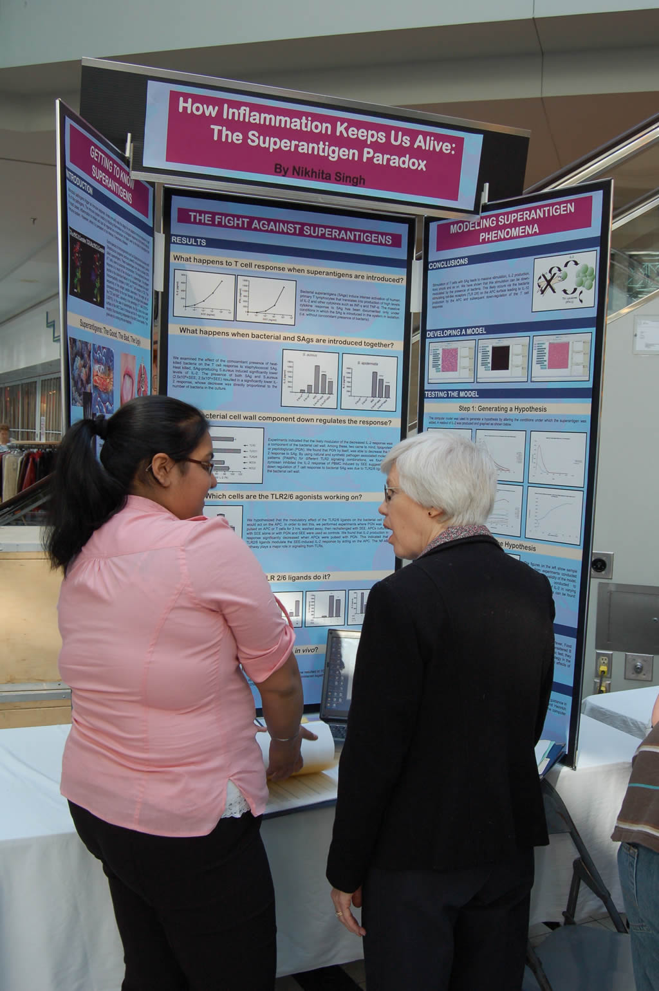
The Art of Judging

Slide 16
Facilitator
Introduce yourself.
Where you come from, what you do.
Ask the exhibitor to introduce her or himself.
Listen respectfully to the presentation.
Ask graded questions
Stop when the limit of knowledge is reached.
Find two things to praise.

Slide 17
Motivator
Focus on the exhibitors.
Ask questions in an upbeat tone.
Listen intently.
Give lots of encouragement.
I liked …
I enjoyed …
Thank them for sharing their project with you.

Slide 18
Role Model
You are
Judge
Scientist
Educational Leader
Business Leader
You represent all of these aspects.
Let the exhibitors say
That was a fantastic judging experience

Slide 19
Judges must not…
Tell a student “You will get an award”.
Convey by body language or otherwise a sense of dismay.
Judge an exhibit seen elsewhere.
Discuss their opinions in public areas.
Treat this as a university examination. Over half the students are in elementary school.
Judge an exhibit beyond their level of expertise. Contact the Division Chief for help.

Slide 20
Cultural Sensitivity
In Muslim communities, it is not appropriate for girls to shake hands with men, and vice versa.
Let the student guide you in appropriate ways of greeting.

Slide 21
Coaching
Coaching can be provided by the Divisional Judges who will keep notes and include this in their decisions.
Coaching is NOT to be provided by the Special Award Judges.

Slide 22
Elementary School Students
Most judges will see only elementary school students.
One of them may be turn into one of the best young scientists in Canada.
The three rules:
Encourage
Encourage
Encourage
Many will be studies, not experiments.

Slide 23
OOPS
The following slides show various ways a judge might convey non-verbal information.
Which is the most appropriate?

Slide 24
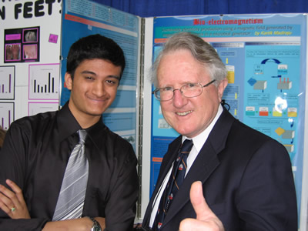
Body Language 2

Slide 25
OOPS 1
Had a call this afternoon from a parent of a senior finalist who said that his son was "devastated" at the award ceremony because the judges had told him he had "an amazing project," that "it was likely to win a Gold Medal" and that his project was "one likely to be chosen to go to the CWSF."
The project received a Bronze Medal.

Slide 26
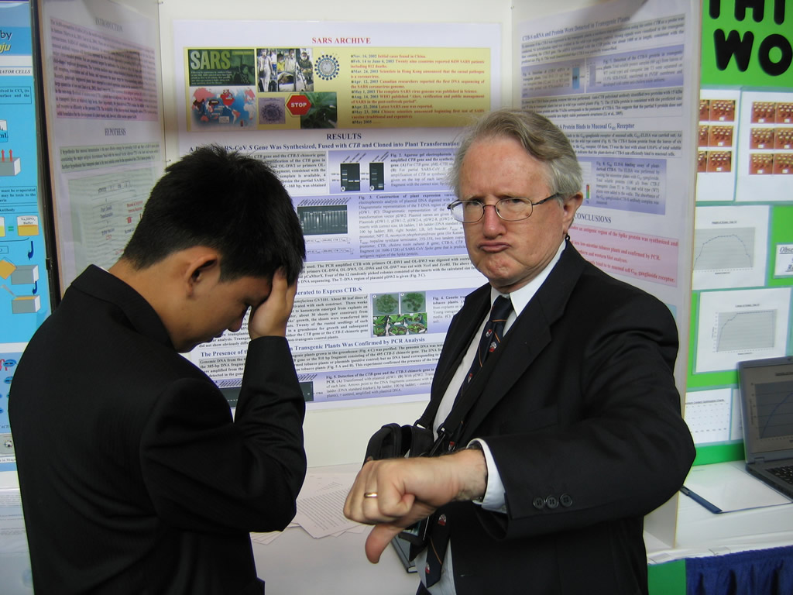

Slide 27
OOPS 2
How did you get selected to come to the Thames Valley Science & Engineering Fair?
You woudn’t get selected from MY school.

Slide 28
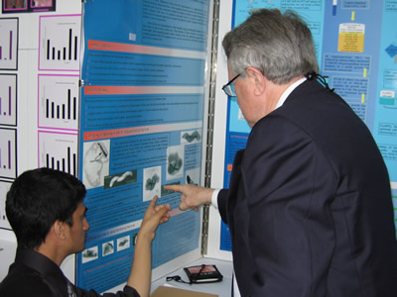
Body Language

Slide 29
OOPS 3
You would have won a Medal if you had just thought to measure the resistance as a function of temperature.
Would you bother to go to the Awards Ceremony?

Slide 30
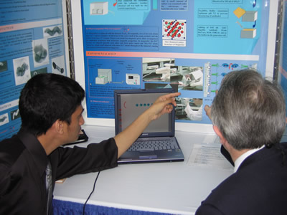
Body Language 3

Slide 31
Best
I enjoyed meeting you.
I particularly liked the idea of measuring magnetic properties of bacteria – very creative.
The measuring circuit was a clever application of this type of amplifier.

Slide 32
Which do you Prefer?
Body Language

Slide 33
Cerebral Palsy
One judge was so “appalled” that the student used “retarded” in the presentation, he gave him a 6.
I was quite shocked as to how unprofessional their judging comments were and how hard they were on the students.
I did not write down this judge’s comments in the amalgamated feedback form as his comments were cruel and would have crushed a little child’s spirit.
I have children that are just beginning school and I would never let them enter a competition that so unfairly judges them
Be aware of your own biases
Some details have been changed to preserve anonymity

Slide 34
Contacting a participant after the Fair
If you wish to contact a student after the Fair, for example to offer extra advice or research support, you must contact the Chief Judge who will initiate contact on your behalf
Judges may not contact school students directly, outside their role as judge.

Slide 35
Name Badge
Please hand these in before you leave so we can use them next year.

Slide 36
Acknowledgements
We wish to thank these participants who have allowed elements of their superb science fair projects to be used in this workshop.
Kartic Madiraju - Montreal
David Wang – London

